Slide 1
Theory of Computation
Lecture 7
NFA to DFA
Tabular Subset Construction methods
Dr. Samar Hesham
Department of Computer Science
Faculty of Computers and Artificial Intelligence
Cairo University
Egypt

Slide 2
Syllabus and Terminologies
Regular Languages .. Regular Sets
REs (Regular Expressions)
FSMs (or FSA/FA) … Finite State Machines/Automata
DFA vs. NFA … Deterministic vs. Non-deterministic FSA
Comparison and Conversion
Examples & Closure Operations
Context Free Languages
CFGs … Context Free Grammars
PDA … Push Down Automata
Parsing: CFG generating strings vs. PDA recognizing strings
Turing Machine

Slide 3
NFA to DFA Tabular Method Subset Construction Method

Slide 4
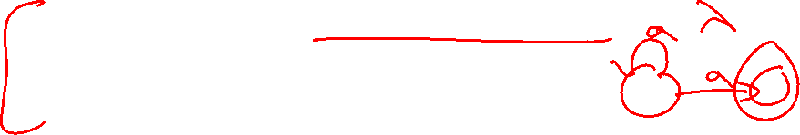
Non Deterministic Features of NFA
There are three main cases of non- determinism in NFAs:
Transition to a state without consuming any input.
Multiple transitions on the same input symbol.
No transition on an input symbol.
To convert NFAs to DFAs we need to get rid of non-determinism from NFAs.

Slide 5
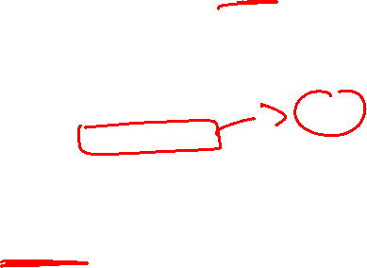
Subset Construction Method
Using Subset construction method to convert NFA to DFA involves the following steps:
For every state in the NFA, determine all reachable states for every input symbol.
The set of reachable states constitute a single state in the converted DFA (Each state in the DFA corresponds to a subset of states in the NFA).
Find reachable states for each new DFA state, until no more new states can be found.

Slide 6
Subset Construction Method
Fig1. NFA without λ-transitions

Slide 7

Subset Construction Method
Fig1. NFA without λ-transitions
Step1
3
b
a
a
a
2
a
b
Construct a transition table showing all reachable states for every state for every input signal.
1
a,b
5
a,b
a
4
b

Slide 8
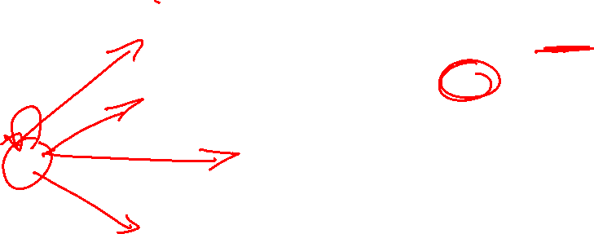
Subset Construction Method
Fig2. Transition table
Fig1. NFA without λ-transitions
3
q | δ(q,a) | δ(q,b)
1 | {1,2,3,4,5} | {4,5}
2 | {3} | {5}
3 | ∅ | {2}
4 | {5} | {4}
5 | ∅ | ∅
b
a
???
a
???
a
2
a
b
???
???
1
a,b
5
???
???
a,b
a
???
???
4
???
???
b

Slide 9
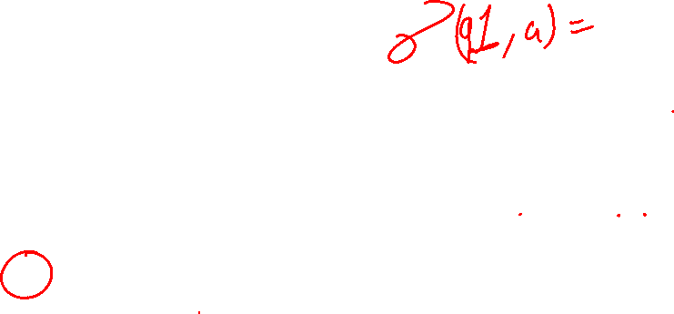
Subset Construction Method
Transition from state q with input a
Fig2. Transition table
Transition from state q with input b
Fig1. NFA without λ-transitions
3
q | δ(q,a) | δ(q,b)
1 | {1,2,3,4,5} | {4,5}
2 | {3} | {5}
3 | ∅ | {2}
4 | {5} | {4}
5 | ∅ | ∅
b
a
Starts here
???
a
???
a
2
a
b
???
???
1
a,b
5
???
???
a,b
a
???
???
4
???
???
b

Slide 10

Subset Construction Method
Fig2. Transition table
q | δ(q,a) | δ(q,b)
1 | {1,2,3,4,5} | {4,5}
2 | {3} | {5}
3 | ∅ | {2}
4 | {5} | {4}
5 | ∅ | ∅
Step2
The set of states resulting from every transition function constitutes a new state. Calculate all reachable states for every such state for every input signal.

Slide 11
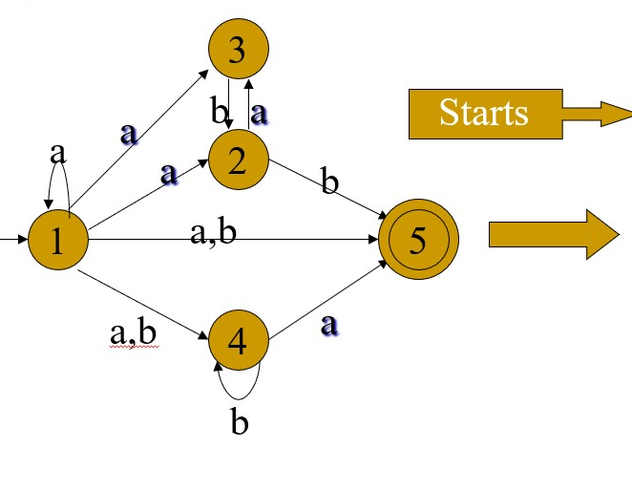
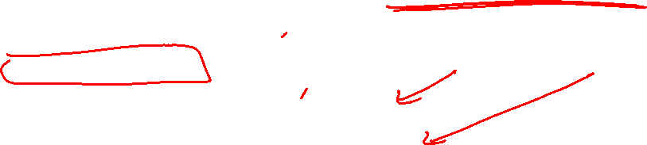
Fig3. Subset Construction table
q | δ(q,a) | δ(q,b)
1 | {1,2,3,4,5} | {4,5}
2 | {3} | {5}
3 | ∅ | {2}
4 | {5} | {4}
5 | ∅ | ∅
Starts with
Initial state
q | δ(q,a) | δ(q,b)
1 | {1,2,3,4,5} | {4,5}

Slide 12
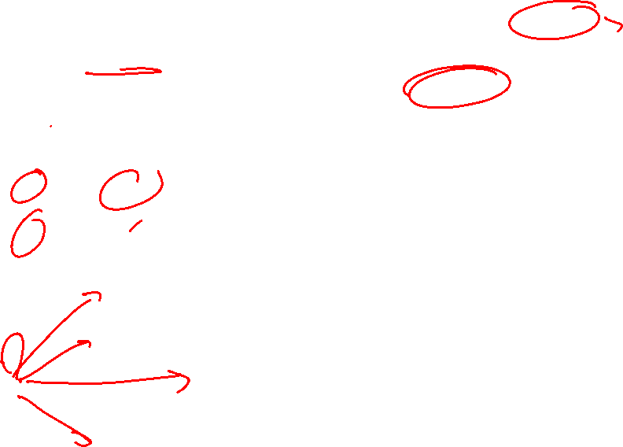
Fig2. Transition table
Fig3. Subset Construction table
q | δ(q,a) | δ(q,b)
1 | {1,2,3,4,5} | {4,5}
2 | {3} | {5}
3 | ∅ | {2}
4 | {5} | {4}
5 | ∅ | ∅
Starts with
Initial state
q | δ(q,a) | δ(q,b)
1 | {1,2,3,4,5} | {4,5}
{1,2,3,4,5}
{4,5}

Slide 13
Fig2. Transition table
Fig3. Subset Construction table
q | δ(q,a) | δ(q,b)
1 | {1,2,3,4,5} | {4,5}
2 | {3} | {5}
3 | ∅ | {2}
4 | {5} | {4}
5 | ∅ | ∅
Starts with
Initial state
q | δ(q,a) | δ(q,b)
1 | {1,2,3,4,5} | {4,5}
{1,2,3,4,5}
{4,5}
Step3
Repeat this process(step2) until no more new states are reachable.

Slide 14
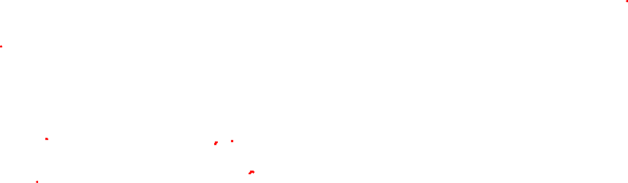
Fig3. Subset Construction table
Fig2. Transition table
q | δ(q,a) | δ(q,b)
1 | {1,2,3,4,5} | {4,5}
2 | {3} | {5}
3 | ∅ | {2}
4 | {5} | {4}
5 | ∅ | ∅
q | δ(q,a) | δ(q,b)
1 | {1,2,3,4,5} | {4,5}
{1,2,3,4,5} | {1,2,3,4,5} | {2,4,5}
{4,5}
{2,4,5}
???
???

Slide 15
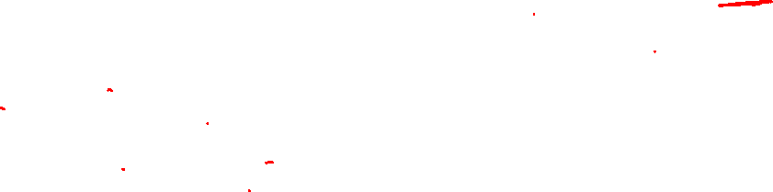
Fig3. Subset Construction table
Fig2. Transition table
q | δ(q,a) | δ(q,b)
1 | {1,2,3,4,5} | {4,5}
2 | {3} | {5}
3 | ∅ | {2}
4 | {5} | {4}
5 | ∅ | ∅
q | δ(q,a) | δ(q,b)
1 | {1,2,3,4,5} | {4,5}
{1,2,3,4,5} | {1,2,3,4,5} | {2,4,5}
{4,5} | 5 | 4
{2,4,5}
5
4
???
???

Slide 16
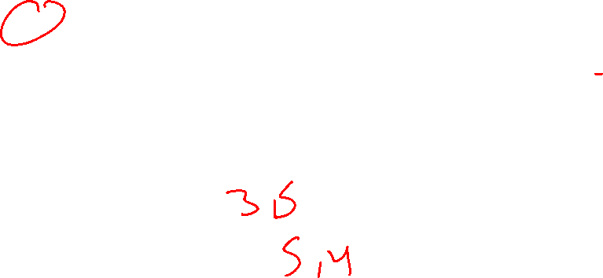
Fig3. Subset Construction table
Fig2. Transition table
q | δ(q,a) | δ(q,b)
1 | {1,2,3,4,5} | {4,5}
2 | {3} | {5}
3 | ∅ | {2}
4 | {5} | {4}
5 | ∅ | ∅
q | δ(q,a) | δ(q,b)
1 | {1,2,3,4,5} | {4,5}
{1,2,3,4,5} | {1,2,3,4,5} | {2,4,5}
{4,5} | 5 | 4
{2,4,5} | {3,5} | {4,5}
5
4
{3,5}
???
???

Slide 17
Fig3. Subset Construction table
Fig2. Transition table
q | δ(q,a) | δ(q,b)
1 | {1,2,3,4,5} | {4,5}
2 | {3} | {5}
3 | ∅ | {2}
4 | {5} | {4}
5 | ∅ | ∅
q | δ(q,a) | δ(q,b)
1 | {1,2,3,4,5} | {4,5}
{1,2,3,4,5} | {1,2,3,4,5} | {2,4,5}
{4,5} | 5 | 4
{2,4,5} | {3,5} | {4,5}
5 | ∅ | ∅
4
{3,5}
∅
???
???

Slide 18

Fig3. Subset Construction table
Fig2. Transition table
q | δ(q,a) | δ(q,b)
1 | {1,2,3,4,5} | {4,5}
2 | {3} | {5}
3 | ∅ | {2}
4 | {5} | {4}
5 | ∅ | ∅
q | δ(q,a) | δ(q,b)
1 | {1,2,3,4,5} | {4,5}
{1,2,3,4,5} | {1,2,3,4,5} | {2,4,5}
{4,5} | 5 | 4
{2,4,5} | {3,5} | {4,5}
5 | ∅ | ∅
4 | 5 | 4
{3,5}
∅
???
???
We already got 4 and 5.
So we don’t add them again.

Slide 19

Fig3. Subset Construction table
Fig2. Transition table
q | δ(q,a) | δ(q,b)
1 | {1,2,3,4,5} | {4,5}
2 | {3} | {5}
3 | ∅ | {2}
4 | {5} | {4}
5 | ∅ | ∅
q | δ(q,a) | δ(q,b)
1 | {1,2,3,4,5} | {4,5}
{1,2,3,4,5} | {1,2,3,4,5} | {2,4,5}
{4,5} | 5 | 4
{2,4,5} | {3,5} | {4,5}
5 | ∅ | ∅
4 | 5 | 4
{3,5} | ∅ | 2
∅
2
???
???

Slide 20
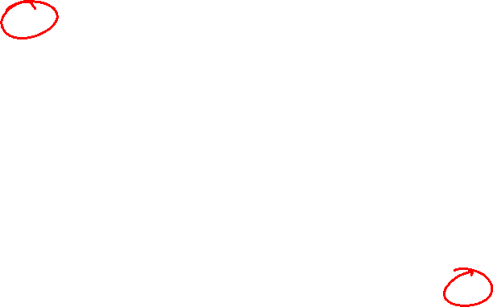
Fig3. Subset Construction table
Fig2. Transition table
q | δ(q,a) | δ(q,b)
1 | {1,2,3,4,5} | {4,5}
2 | {3} | {5}
3 | ∅ | {2}
4 | {5} | {4}
5 | ∅ | ∅
q | δ(q,a) | δ(q,b)
1 | {1,2,3,4,5} | {4,5}
{1,2,3,4,5} | {1,2,3,4,5} | {2,4,5}
{4,5} | 5 | 4
{2,4,5} | {3,5} | {4,5}
5 | ∅ | ∅
4 | 5 | 4
{3,5} | ∅ | 2
∅ | ∅ | ∅
2
???
???

Slide 21

Fig3. Subset Construction table
Fig2. Transition table
q | δ(q,a) | δ(q,b)
1 | {1,2,3,4,5} | {4,5}
2 | {3} | {5}
3 | ∅ | {2}
4 | {5} | {4}
5 | ∅ | ∅
q | δ(q,a) | δ(q,b)
1 | {1,2,3,4,5} | {4,5}
{1,2,3,4,5} | {1,2,3,4,5} | {2,4,5}
{4,5} | 5 | 4
{2,4,5} | {3,5} | {4,5}
5 | ∅ | ∅
4 | 5 | 4
{3,5} | ∅ | 2
∅ | ∅ | ∅
2 | 3 | 5
3
???
???

Slide 22

Fig3. Subset Construction table
Fig2. Transition table
q | δ(q,a) | δ(q,b)
1 | {1,2,3,4,5} | {4,5}
2 | {3} | {5}
3 | ∅ | {2}
4 | {5} | {4}
5 | ∅ | ∅
q | δ(q,a) | δ(q,b)
1 | {1,2,3,4,5} | {4,5}
{1,2,3,4,5} | {1,2,3,4,5} | {2,4,5}
{4,5} | 5 | 4
{2,4,5} | {3,5} | {4,5}
5 | ∅ | ∅
4 | 5 | 4
{3,5} | ∅ | 2
∅ | ∅ | ∅
2 | 3 | 5
3 | ∅ | 2
Stops here as there are no more reachable states
???
???

Slide 23
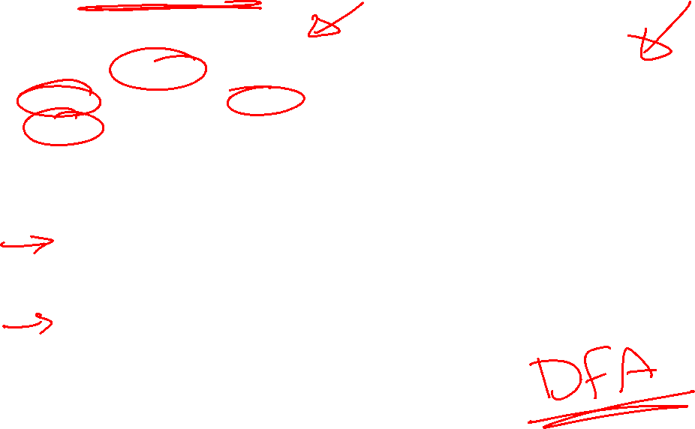
Fig4. Resulting FA after applying Subset Construction to Fig1.
Fig3. Subset Construction table
a
q | δ(q,a) | δ(q,b)
1 | {1,2,3,4,5} | {4,5}
{1,2,3,4,5} | {1,2,3,4,5} | {2,4,5}
{4,5} | 5 | 4
{2,4,5} | {3,5} | {4,5}
5 | ∅ | ∅
4 | 5 | 4
{3,5} | ∅ | 2
∅ | ∅ | ∅
2 | 3 | 5
3 | ∅ | 2
b
a
12345
245
35
a
a,b
a
b
∅
a
b
1
3
a,b
b
b
a
a
2
45
5
b
b
4
a
b

